Slide 1

Geometry
Unit 4, Lesson 5 Algebraic Descriptions of a Sequence of Transformations Volume 1, pg. 201

Slide 2


Benchmarks
MA.912.GR.2.1 Given a preimage and image, describe the transformation and represent the transformation algebraically using coordinates.
MA.912.GR.2.5 Given a geometric figure and a sequence of transformations, draw the transformed figure on a coordinate plane.
volume 1, pg. 201

Slide 3
Integrated Mathematical Thinking and Reasoning Standards
MA.K12.MTR.3.1 Complete tasks with mathematical fluency.
MA.K12.MTR.4.1 Engage in discussions that reflect on the mathematical thinking of self and others.
MA.K12.MTR.5.1 Use patterns and structure to help understand and connect mathematical concepts.
MA.K12.MTR.6.1 Assess the reasonableness of solutions.
volume 1, pg. 201

Slide 4

Learning Targets
I can draw an image given a pre-image and an algebraic description of a sequence of transformations on a coordinate plane.
I can write a transformation on the coordinate plane using coordinate notation with algebraic descriptors.
volume 1, pg. 201

Slide 5

Warm-Up
volume 1, pg. 202

Slide 6
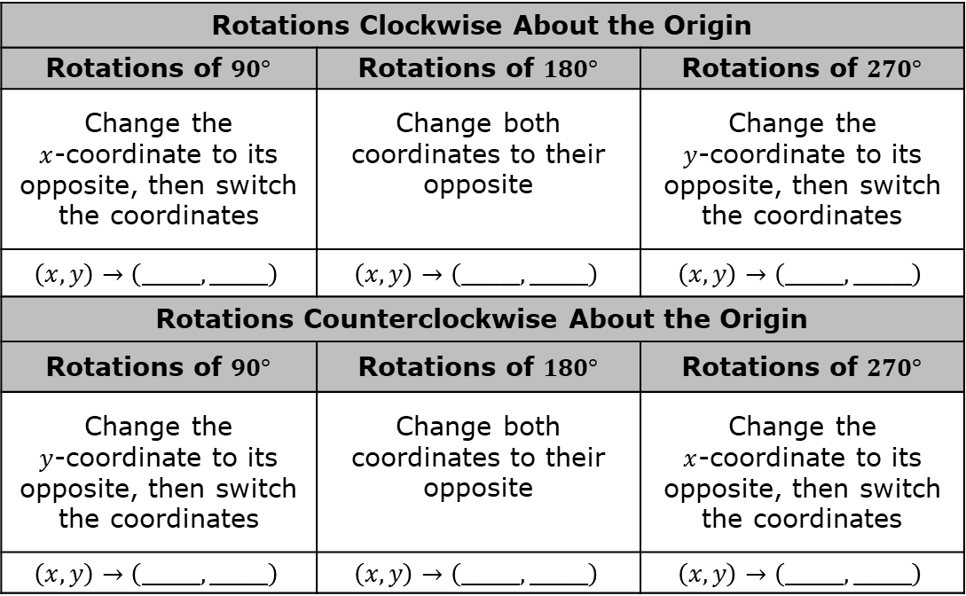
4.5.1 Warm-Up: Algebraic Descriptions of Transformations
Use your notes to complete the algebraic descriptions in the table.
The Effect of Transformations on Coordinates
a.
Rotations Clockwise About the Origin
Rotations of $90°$ | Rotations of $180°$ | Rotations of $270°$
Change the $x$‑coordinate to its opposite, then switch the coordinates | Change both coordinates to their opposite | Change the $y$‑coordinate to its opposite, then switch the coordinates
$$\left(x,y\right)→\left(______,______\right)$$ | $$\left(x,y\right)→\left(______,______\right)$$ | $$\left(x,y\right)→\left(______,______\right)$$
Rotations Counterclockwise About the Origin
Rotations of $90°$ | Rotations of $180°$ | Rotations of $270°$
Change the $y$‑coordinate to its opposite, then switch the coordinates | Change both coordinates to their opposite | Change the $x$‑coordinate to its opposite, then switch the coordinates
$$\left(x,y\right)→\left(______,______\right)$$ | $$\left(x,y\right)→\left(______,______\right)$$ | $$\left(x,y\right)→\left(______,______\right)$$
volume 1, pg. 202

Slide 7
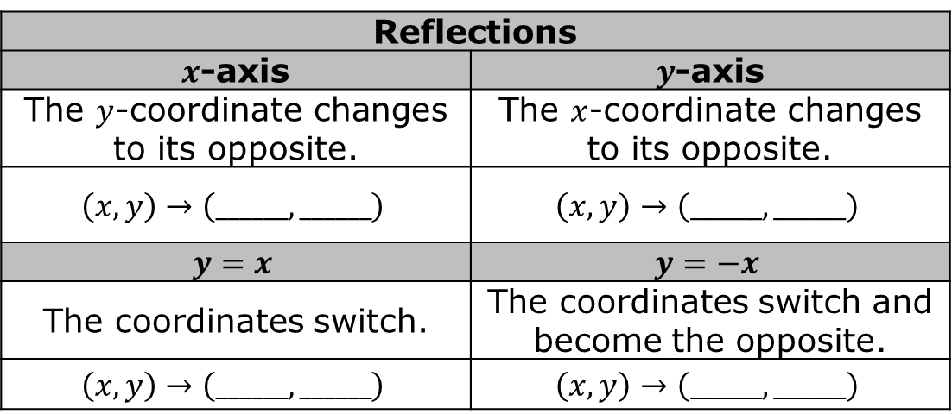
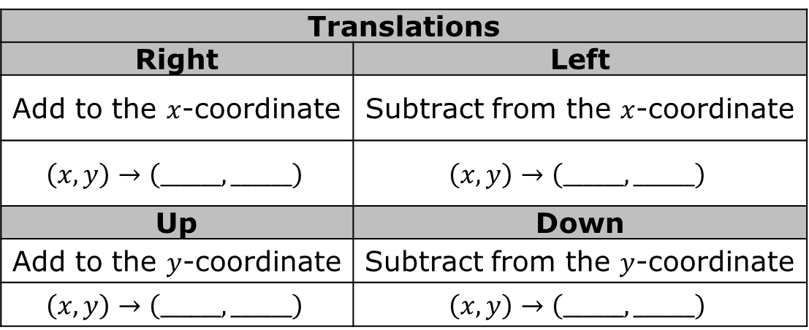
b.
Translations
Right | Left
Add to the $x$‑coordinate | Subtract from the $x$‑coordinate
$$\left(x,y\right)→\left(______,______\right)$$ | $$\left(x,y\right)→\left(______,______\right)$$
Up | Down
Add to the $y$‑coordinate | Subtract from the $y$‑coordinate
$$\left(x,y\right)→\left(______,______\right)$$ | $$\left(x,y\right)→\left(______,______\right)$$
c.
Reflections
$x$-axis | $y$-axis
The $y$‑coordinate changes to its opposite. | The $x$‑coordinate changes to its opposite.
$$\left(x,y\right)→\left(______,______\right)$$ | $$\left(x,y\right)→\left(______,______\right)$$
$$y=x$$ | $$y=−x$$
The coordinates switch. | The coordinates switch and become the opposite.
$$\left(x,y\right)→\left(______,______\right)$$ | $$\left(x,y\right)→\left(______,______\right)$$
volume 1, pg. 202

Slide 8

Guided Instruction
volume 1, pg. 203

Slide 9
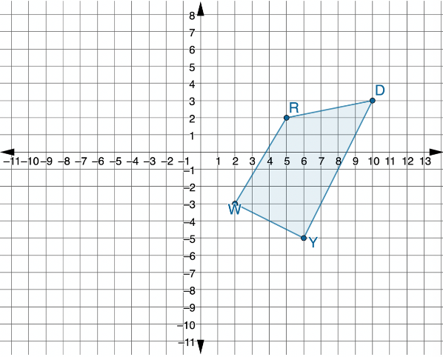
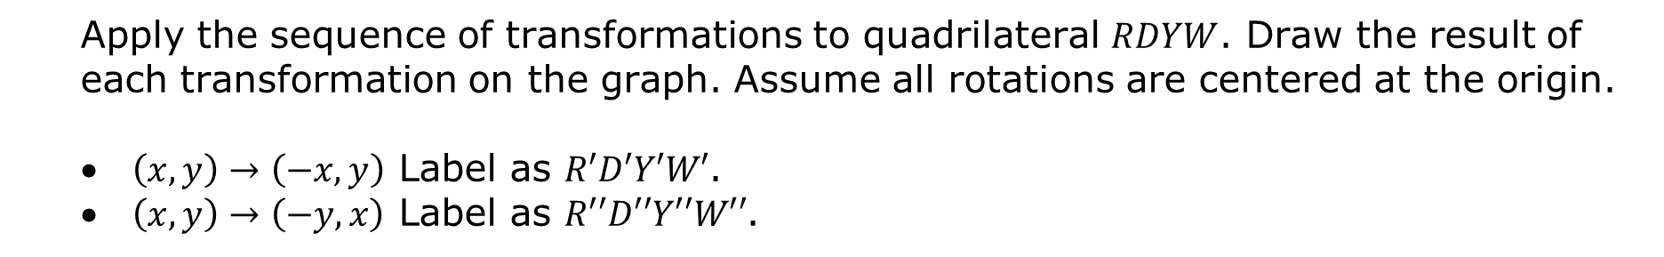
4.5.2 Guided Instruction: Applying Algebraic Descriptions
Quadrilateral $RDYW$ is shown on the coordinate grid.
Apply the sequence of transformations to quadrilateral $RDYW$. Draw the result of each transformation on the graph. Assume all rotations are centered at the origin.
$\left(x,y\right)→\left(−x,y\right)$ Label as $R′D′Y′W′$.
$\left(x,y\right)→\left(−y,x\right)$ Label as $R′′D′′Y′′W′′$.
volume 1, pg. 203

Slide 10
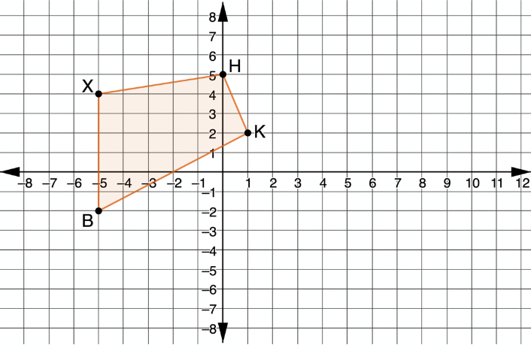
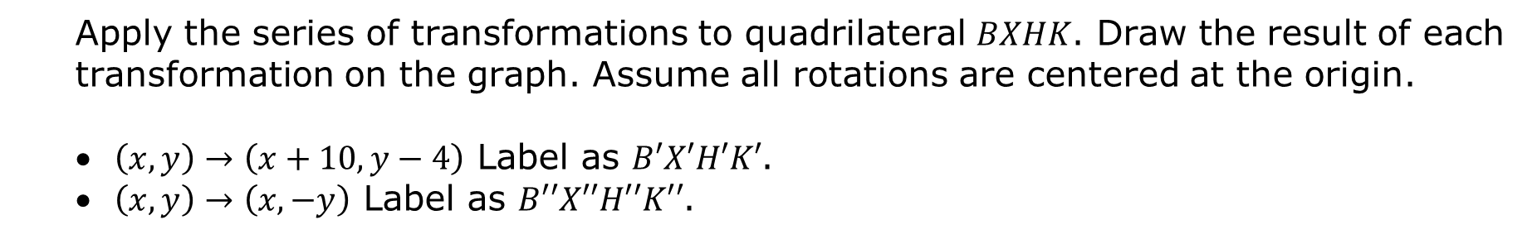
Quadrilateral $BXHK$ is shown on the coordinate grid.
Apply the series of transformations to quadrilateral $BXHK$. Draw the result of each transformation on the graph. Assume all rotations are centered at the origin.
$\left(x,y\right)→\left(x+10,y−4\right)$ Label as $B′X′H′K′$.
$\left(x,y\right)→\left(x,−y\right)$ Label as $B′′X′′H′′K′′$.
volume 1, pg. 203

Slide 11
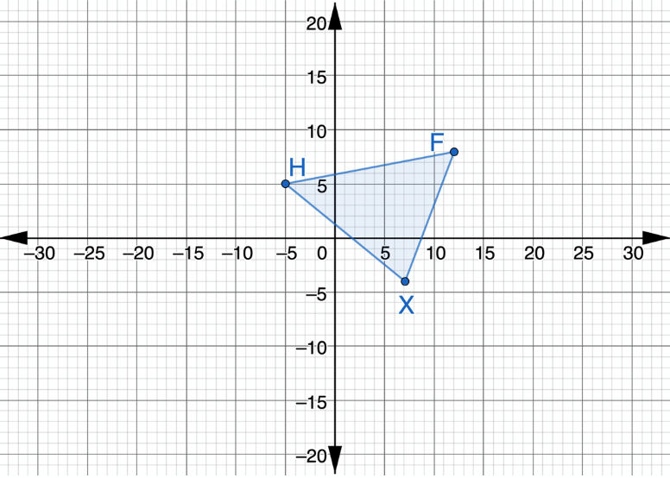
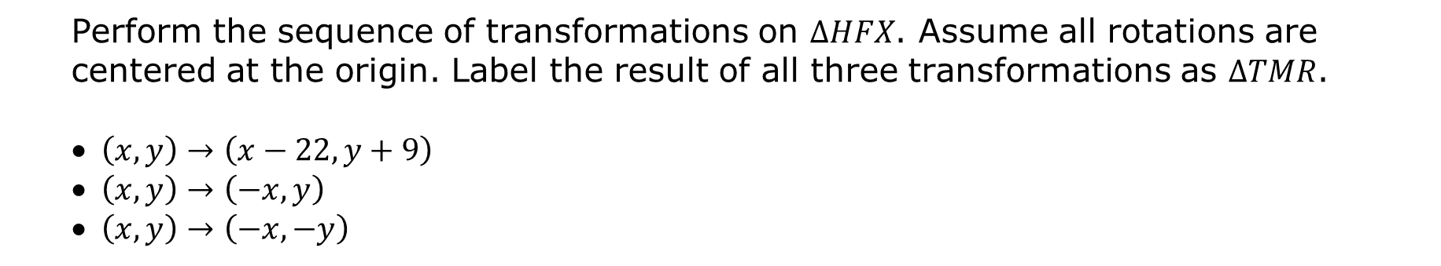
Triangle $HFX$ is shown on the coordinate grid.
Perform the sequence of transformations on $∆HFX$. Assume all rotations are centered at the origin. Label the result of all three transformations as $∆TMR$.
$\left(x,y\right)→\left(x−22,y+9\right)$
$\left(x,y\right)→\left(−x,y\right)$
$\left(x,y\right)→\left(−x,−y\right)$
volume 1, pg. 204

Slide 12

Guided Practice
volume 1, pg. 204

Slide 13

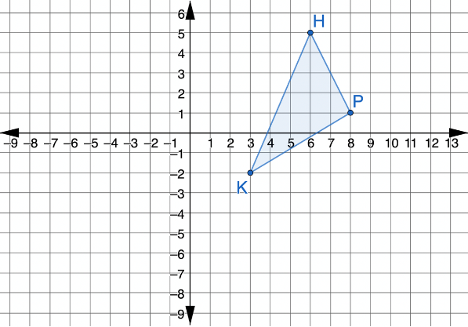
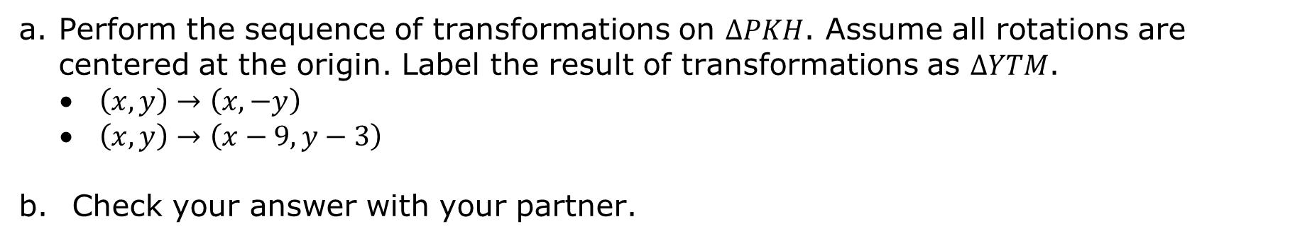
4.5.3 Guided Practice: Applying Algebraic Descriptions
Triangle $PKH$ is shown on the coordinate grid.
Perform the sequence of transformations on $∆PKH$. Assume all rotations are centered at the origin. Label the result of transformations as $∆YTM$.
$\left(x,y\right)→\left(x,−y\right)$
$\left(x,y\right)→\left(x−9,y−3\right)$
Check your answer with your partner.
volume 1, pg. 204

Slide 14
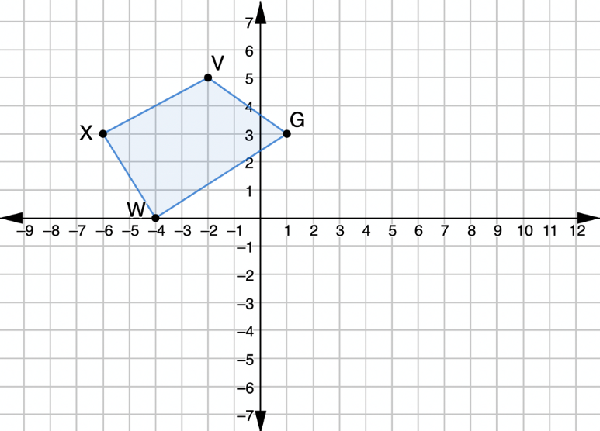
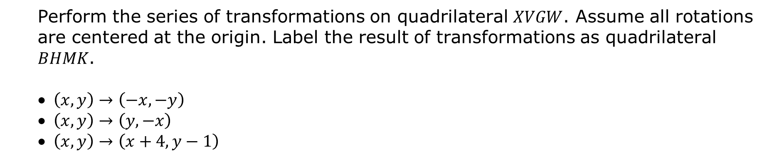
Quadrilateral $XVGW$ is shown on the coordinate grid.
Perform the series of transformations on quadrilateral $XVGW$. Assume all rotations are centered at the origin. Label the result of transformations as quadrilateral $BHMK$.
$\left(x,y\right)→\left(−x,−y\right)$
$\left(x,y\right)→\left(y,−x\right)$
$\left(x,y\right)→\left(x+4,y−1\right)$
volume 1, pg. 205

Slide 15

Your Turn
volume 1, pg. 205

Slide 16
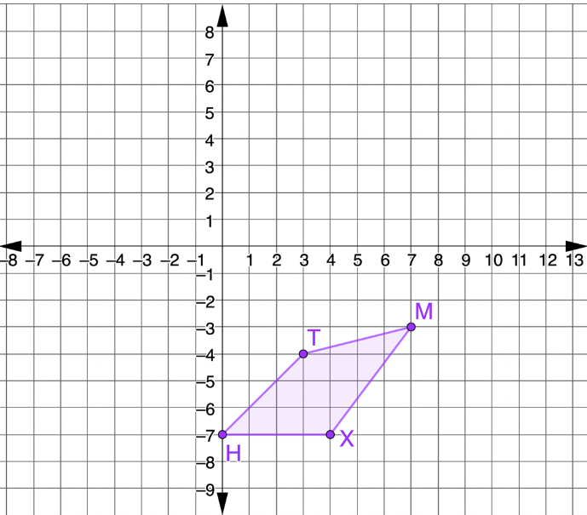
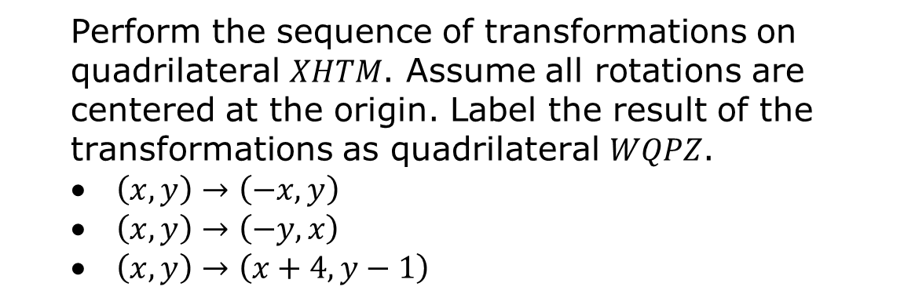
4.5.4 Your Turn!
Quadrilateral $XHTM$ is shown on the coordinate grid.
Perform the sequence of transformations on quadrilateral $XHTM$. Assume all rotations are centered at the origin. Label the result of the transformations as quadrilateral $WQPZ$.
$\left(x,y\right)→\left(−x,y\right)$
$\left(x,y\right)→\left(−y,x\right)$
$\left(x,y\right)→\left(x+4,y−1\right)$
volume 1, pg. 205

Slide 17

Wrap-Up
volume 1, pg. 206

Slide 18
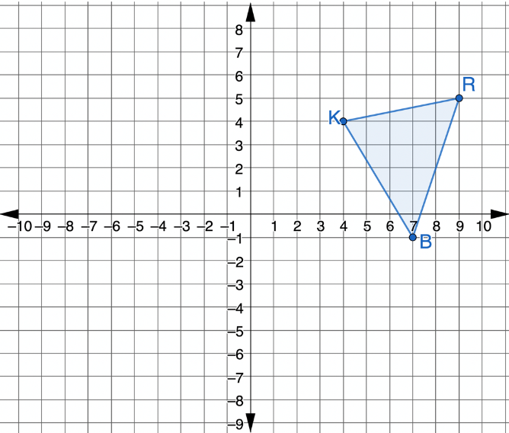
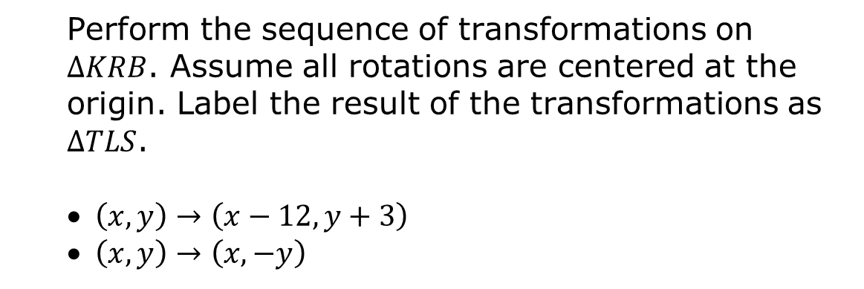
4.5.5 Wrap-Up: Ticket Out the Door
Triangle $KRB$ is shown on the coordinate grid.
Perform the sequence of transformations on $∆KRB$. Assume all rotations are centered at the origin. Label the result of the transformations as $∆TLS$.
$\left(x,y\right)→\left(x−12,y+3\right)$
$\left(x,y\right)→\left(x,−y\right)$
volume 1, pg. 206

